Slide 1
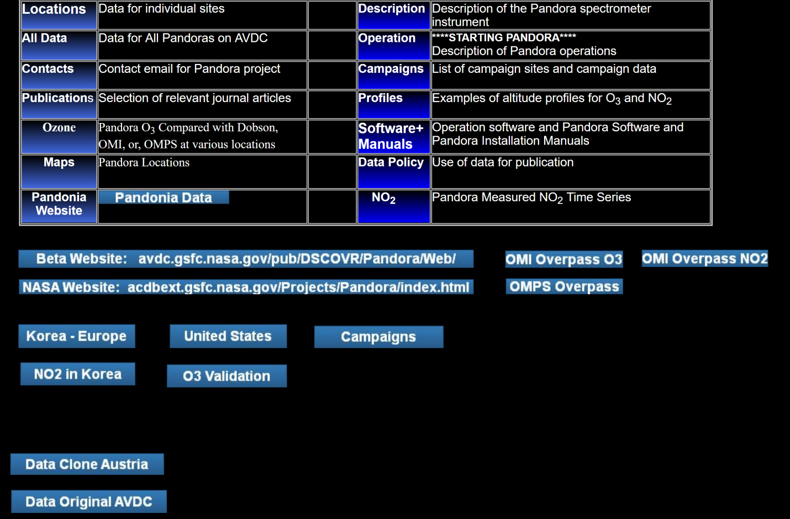
Pandora Data
https://avdc.gsfc.nasa.gov/pub/DSCOVR/Pandora/Web_Pandora/

Slide 2
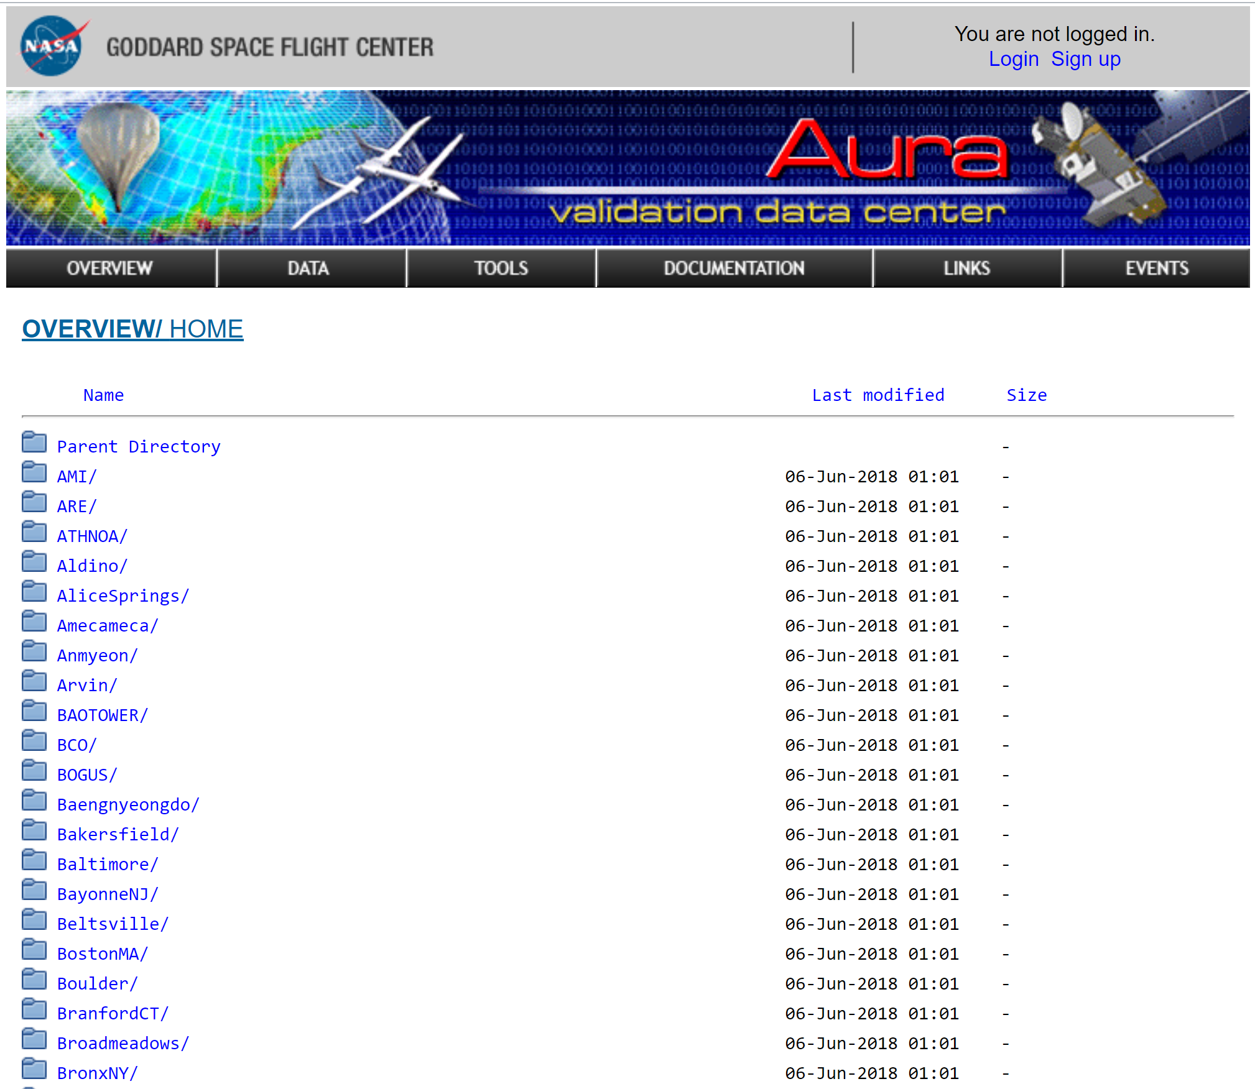

Slide 3
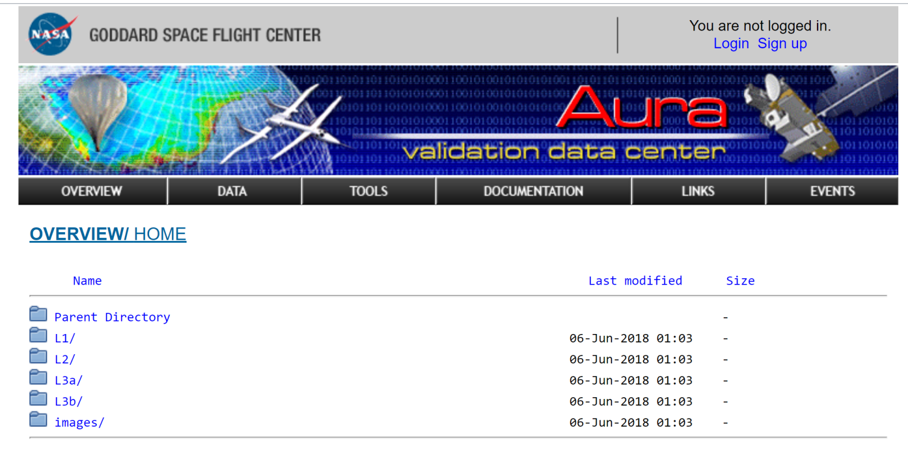

Slide 4
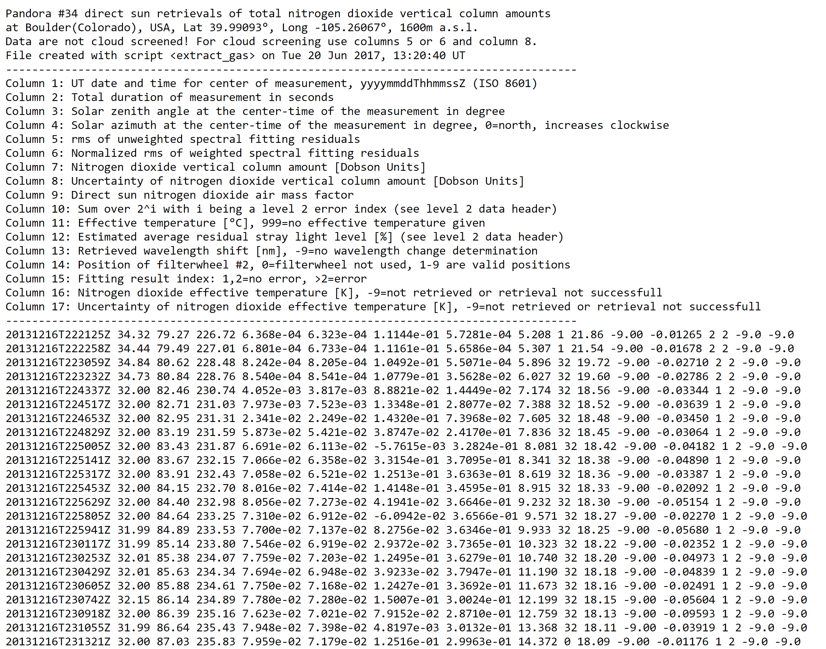
Level 3B NOT Filtered

Slide 5
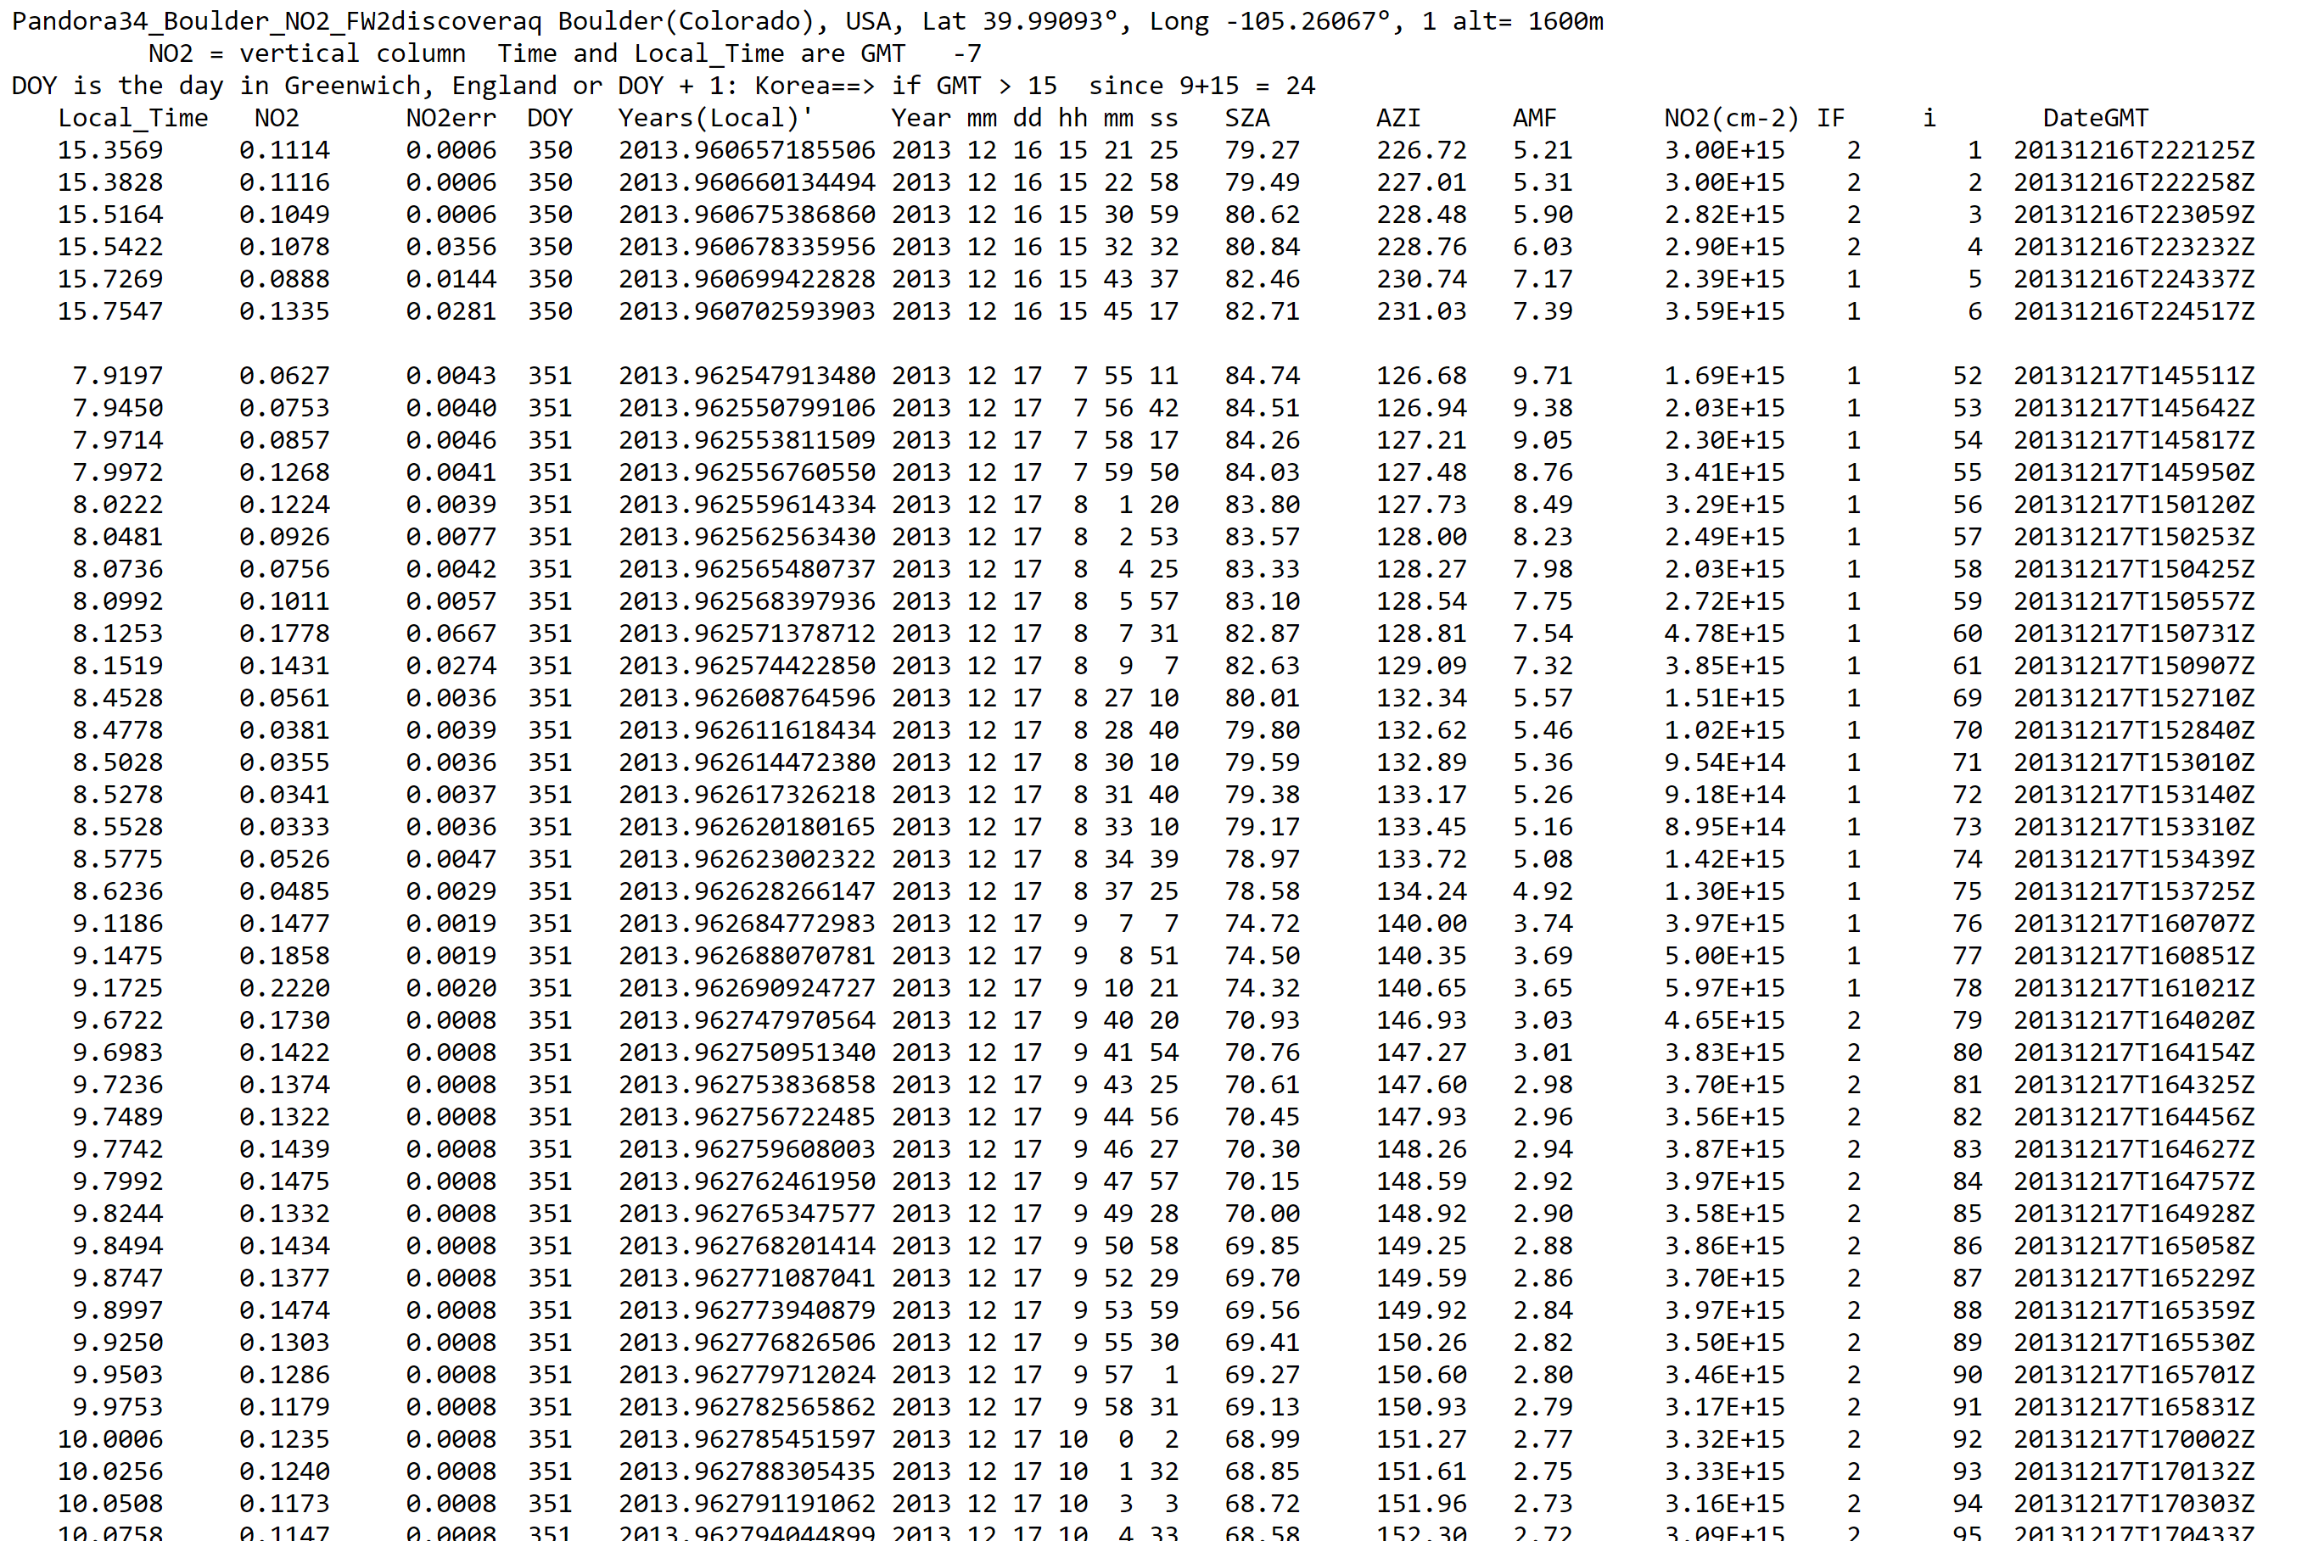
Level 3C Filtered

Slide 6
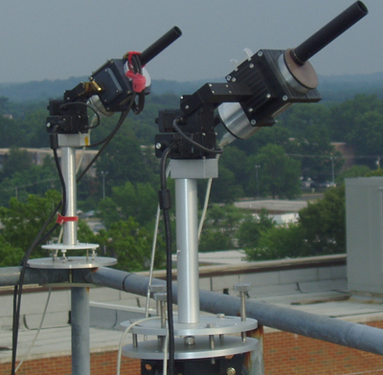
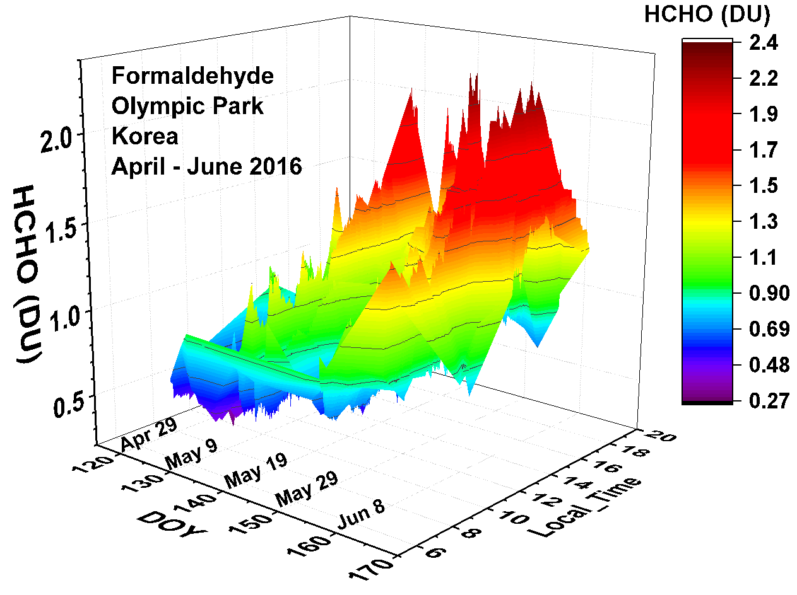
Pandora Measured Diurnal Variation of Formaldehyde
And NO₂
NO₂ and HCHO measurements in Korea from 2012 to 2016 from Pandora Spectrometer Instruments compared with OMI retrievals and with aircraft measurements during the KORUS-AQ campaign
Jay Herman¹, Elena Spinei², Alan Fried³, Jhoon Kim⁴, Jae Kim⁵, Woogyung Kim³,Alexander Cede⁶,Nader Abuhassan¹, Michal Segal-Rozenhaimer^{7,8}, AMT, 2018

Slide 7
Talking Points
Conventional LEO satellites miss the important diurnal variation. Underestimates health effects. We need GEO
Coincident satellite data underestimates amounts of NO₂ and HCHO. Affects tropospheric chemsitry models
Main reason in polluted regions is the large satellite FOV
Aircraft profile data also underestimates total column HCHO
Satellite Error sources for NO₂ or HCHO:
1) AMF 2) Surface Reflectivity 3) selection of spectral window
Satellite Bias: Large FOV

Slide 8
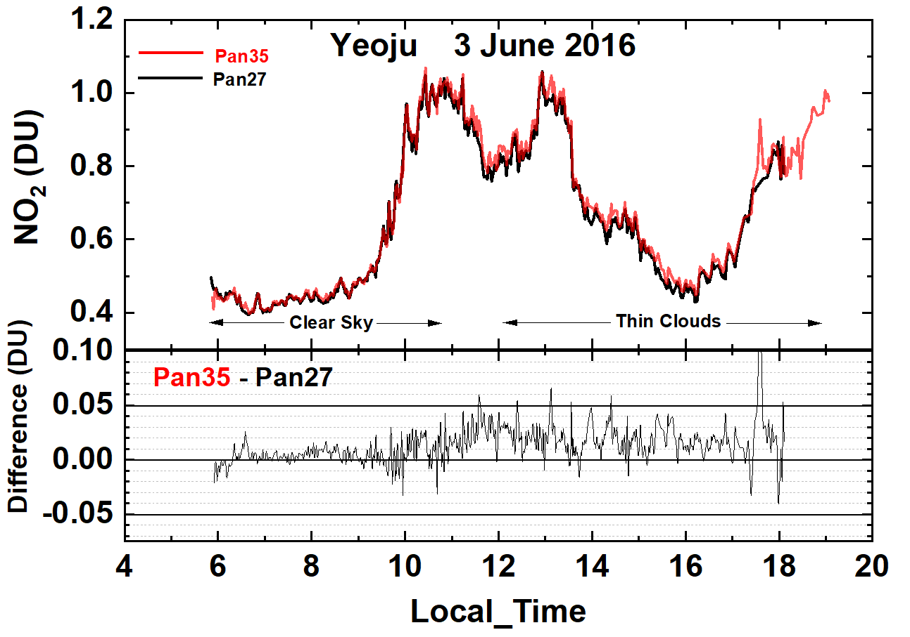
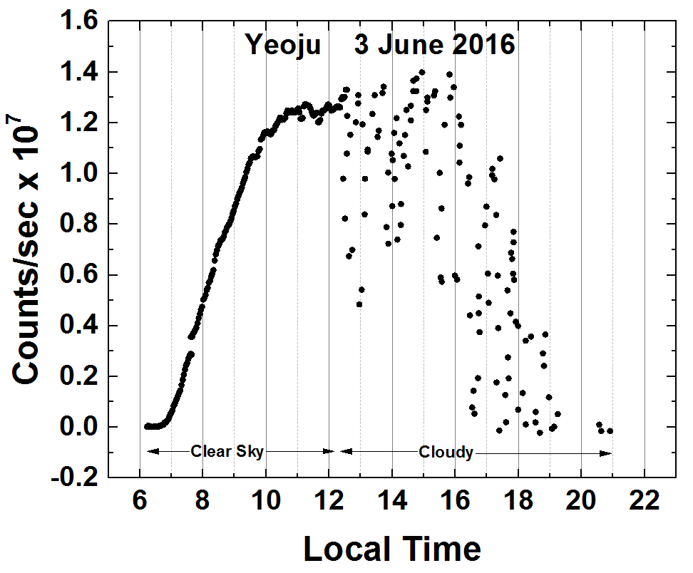
The Effect of Clouds on NO₂ Retrieval
Difference within ± 0.05 DU

Slide 9
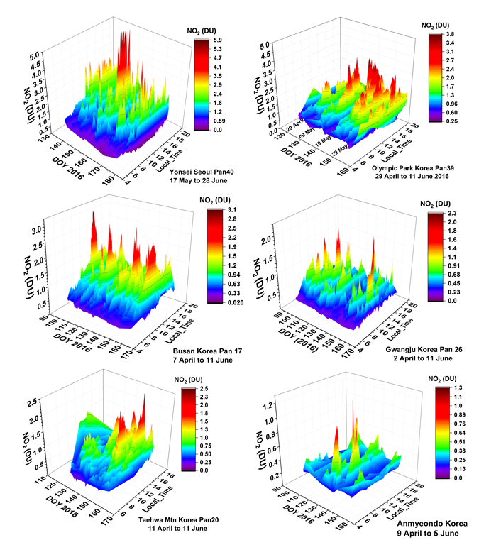
NO₂ Diurnal Variation
Seoul
Olympic
Park
Gwangju
Busan
Taewha
Anmyeondo

Slide 10
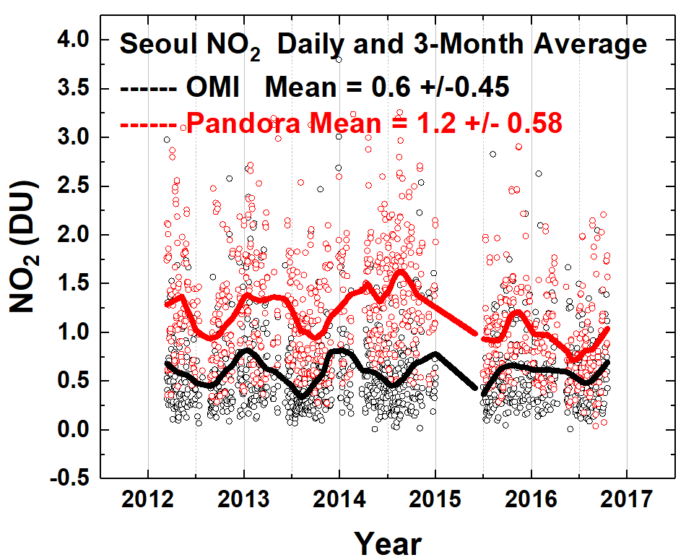
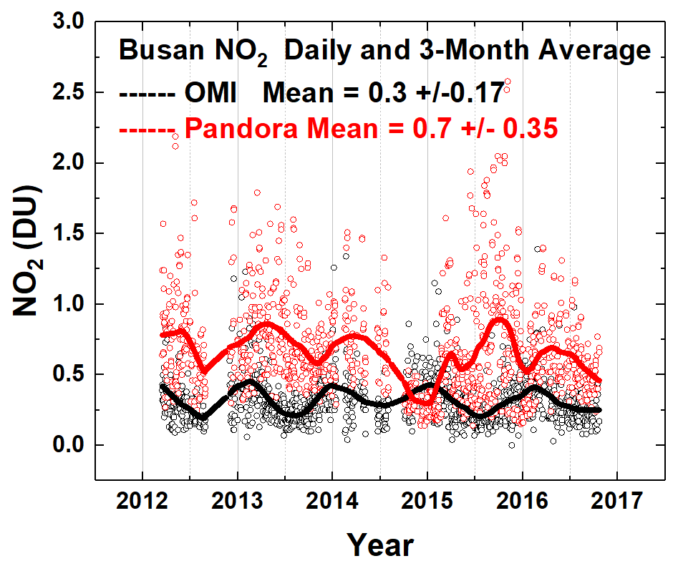
NO₂: Compare Pandora with OMI
Difference mostly due to different FOV
13 x 24 km² for OMI
Distance < 20 km for most points

Slide 11
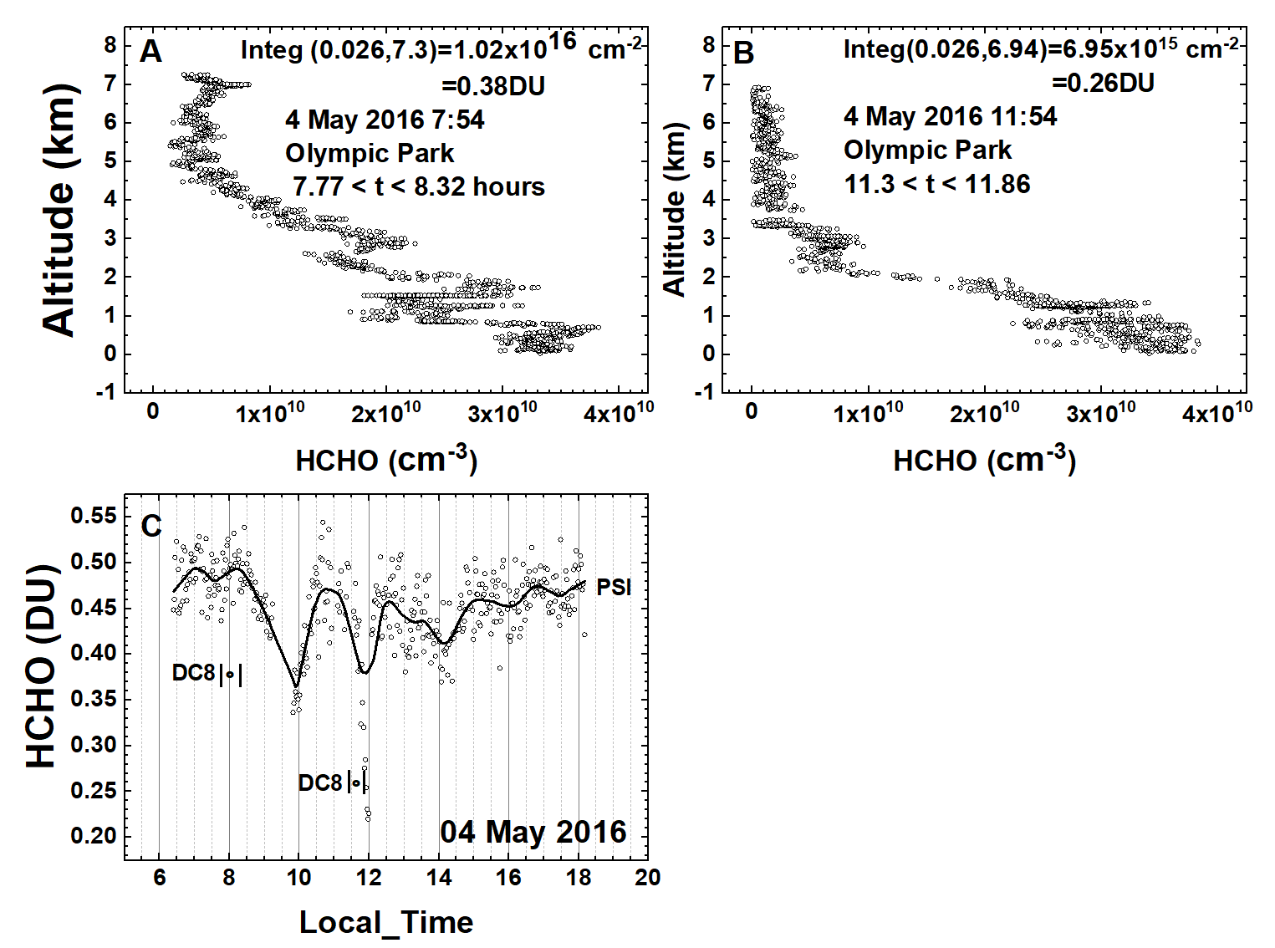
Comparison of Pandora HCHO Measurements with DC8 CAMS
Compact Atmospheric Multispecies Spectrometer (CAMS) (Richter et al., 2015)
4 May 2016
Olympic Park
Korea
CAMS
CAMS
HCHO altitude profile measured onboard the DC8 on 4 May at 07:54 (A) and 11:54 (B) local time over Olympic Park, Korea. Panel C: PSI measurements of C(HCHO). Vertical bars mark the DC8 flight duration for the profiles yielding altitude integrated column amounts of 0.38 and 0.26 DU.

Slide 12
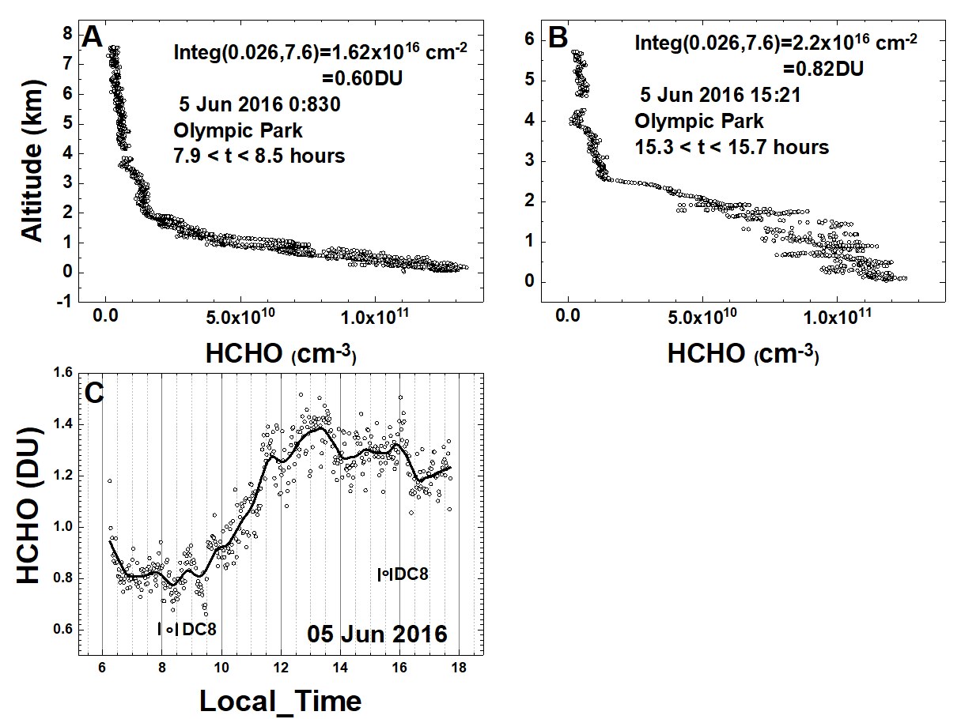
Comparison of Pandora Measurements with DC8 CAMS
Compact Atmospheric Multispecies Spectrometer (CAMS) (Richter et al., 2015)
5 June 2016
Olympic Park
Korea
CAMS
CAMS
HCHO altitude profile measured onboard the DC8 on 5 June at 8:30 (A) and 15:21 (B) local time over Olympic Park, Korea. Panel C: PSI measurements of total column HCHO. Vertical bars mark the DC8 flight duration for the profiles yielding column amounts of 0.60 and 0.82 DU.

Slide 13
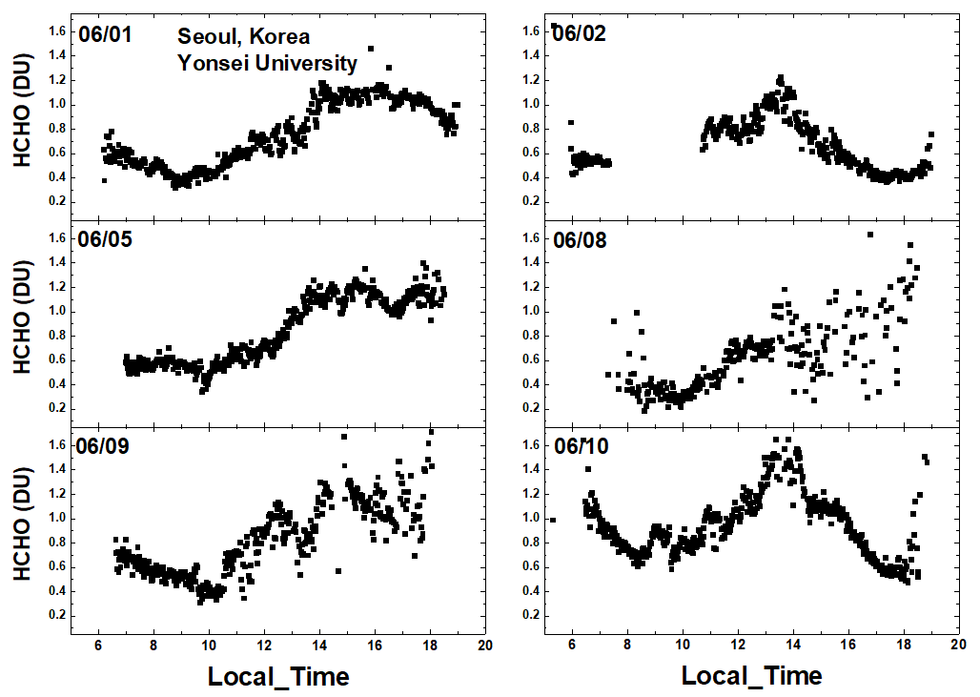
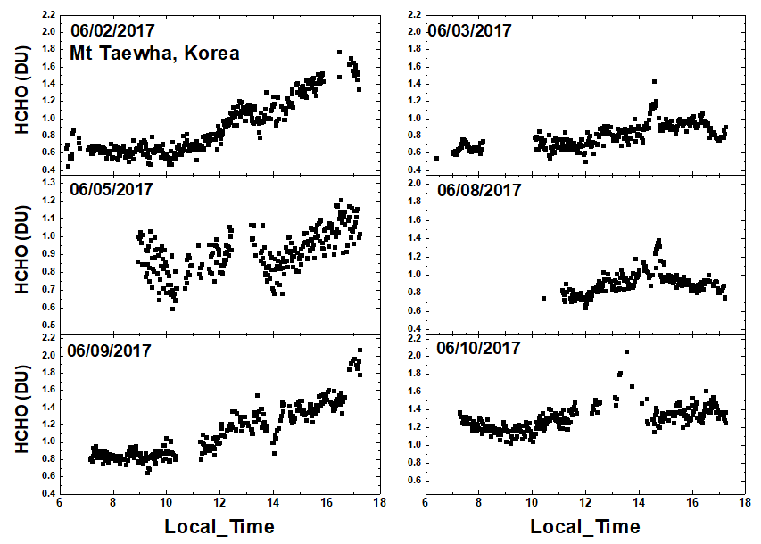
HCHO from Pandora at Yonsei University
Total column HCHO from Pandora Yonsei University, Seoul for 6 days in June 2016. C(HCHO) on 2 June 2016 has a peak value of 1.2 DU at 13:30 hours.
Total column HCHO from Pandora Taehwa Mountain for 6 days in June 2016. C(HCHO) on 2 June 2016 has a peak value of 1.7 DU at 16:20.

Slide 14
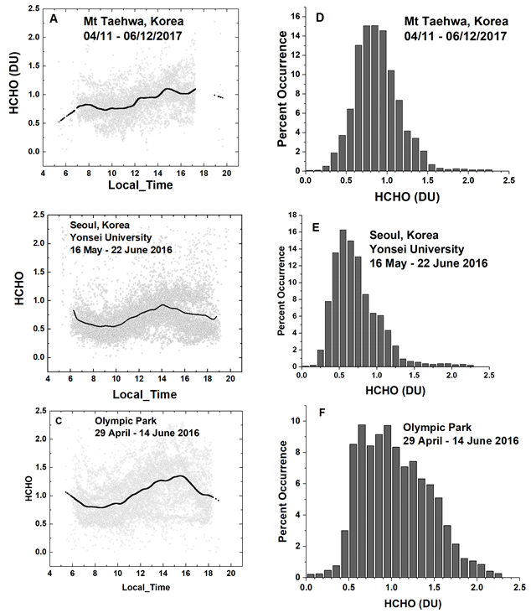
HCHO Frequency of Occurrence
Summary of total column HCHO for the stated dates during the KORUS-AQ campaign. The solid line is a Lowess(0.1) fit to the data. The sharp cutoffs in panel A, B, and C were caused obstructions of the direct sun from the PSI FOV in the afternoon.

Slide 15
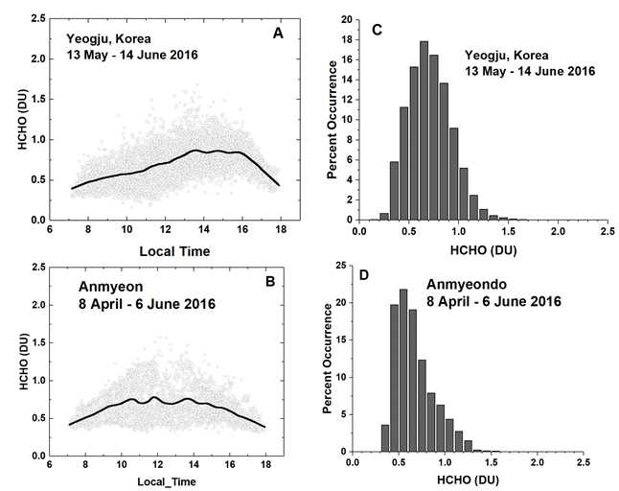
HCHO Frequency of Occurrence
Summary of total column HCHO for the stated dates during the KORUS-AQ campaign. Panels A and B represent the daily variation at a given local time. The solid line is a Lowess(0.1) fit to the data. Panels C and D show the frequency of occurrence (%) for different amounts of HCHO.

Slide 16
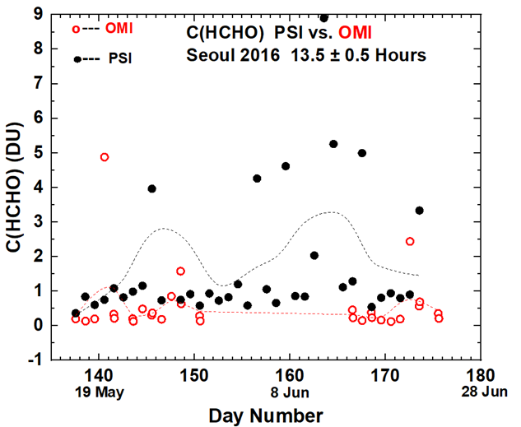
HCHO: Pandora vs OMI
Compare PSI • and OMI o retrievals of C(HCHO) at 13.5 ± 0.5 hours

Slide 17
Conventional LEO satellites miss the important diurnal variation. Underestimates health effects. We need GEO
Coincident satellite data underestimates amounts of NO₂ and HCHO. Affects tropospheric chemsitry models
Main reason in polluted regions is the large satellite FOV
Aircraft profile data also underestimates total column HCHO
Satellite Error sources for NO₂ or HCHO:
1) AMF 2) Surface Reflectivity 3) selection of spectral window
Satellite Bias: Large FOV

